Slide 1
The Water Cycle
Ms. Williams
3rd Grade

Slide 2
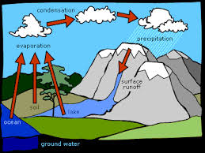
Water Cycle?
http://www.youtube.com/watch?v=hehXEYkDq_Y
Why do we need water?
How might a farmer use water?
Where does water come from?

Slide 3
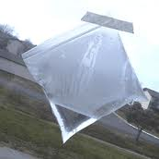
Water Cycle in a bag
7 groups of 3 students and 1 group of 2 students
Names on bag
2 tablespoons of water in bag
Blow air into bag and quickly zip it closed
Tape bag to the window
Fill out Water Cycle in a bag worksheet

Slide 4
Water in a bag cont…
Where do you think the water will go?
Why did we need to place the bag on the window?
What changes do you think you will see inside and outside the bag?

Slide 5
What is a cycle?
A cycle is a recurring sequence of events
Something that happens over and over again
A cycle has no beginning and no ending

Slide 6
What is the water cycle?
The water cycle is the processes by which water circulates between the earth’s oceans, atmosphere, and land, involving precipitation.

Slide 7
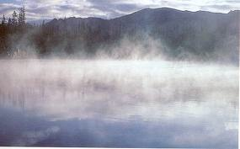
Evaporation
When water is heated by the sun, it rises as an invisible vapor in the atmosphere

Slide 8
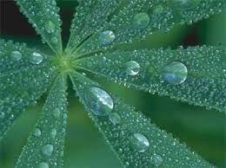
Condensation
As water vapor rises, it cools and eventually condenses.
When it condenses it becomes a liquid again
These water particles then collect and form clouds
Can anyone explain condensation in their own words?
Has anyone ever poured some water into a class and after awhile seen the “sweat” on the outside of the class?

Slide 9
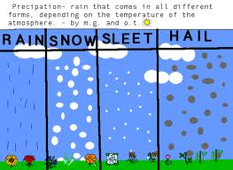
Precipitation
The different forms that come from the clouds
What different forms of precipitation have you seen?

Slide 10
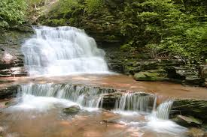
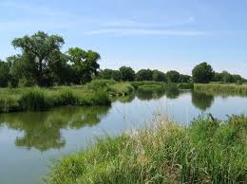
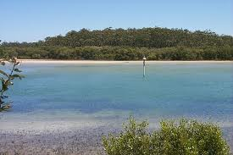
Surface Water
The water that is seen on the ground, such as lakes and rivers

Slide 11
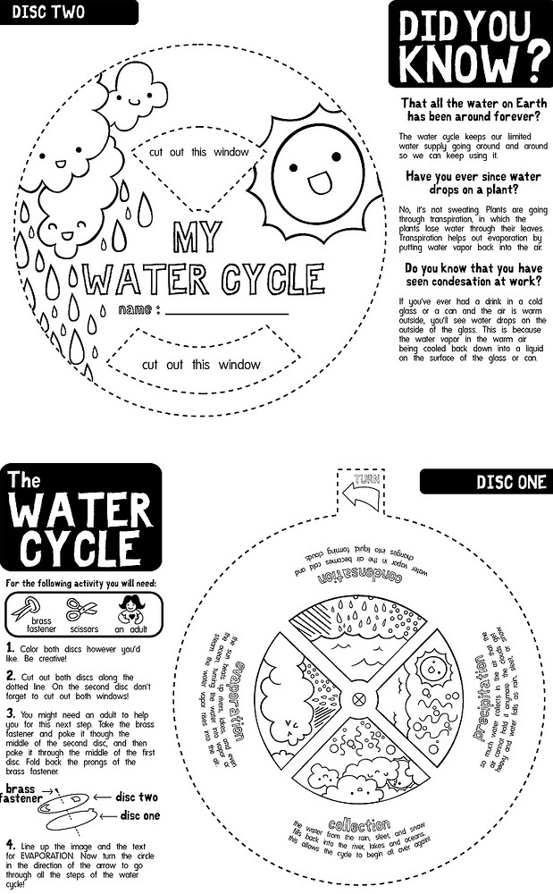
Water Cycle Wheel
Color your wheel
Cut out the wheels
Put the brass fasteners through the top wheel then line it up and put it through the bottom wheel
Line up the text and image for evaporation

Slide 12
Back to your window bags
Go back to your water cycle in a bags
In your groups write down what is now different about your bag?
Once you are done come and sit back on the carpet
What did your group see that was different?
How did the bag show the water cycle?
What parts of the water cycle could you see?

Slide 13
The Tiny Water Droplet
Go back to your seats and work on your tiny water drop worksheet
Write a story about one tiny water droplet and how it goes through the water cycle
Make it CREATIVE!!
Include all the steps to the water cycle and vocabulary words
Draw an illustration to go with your story

